Slide 1

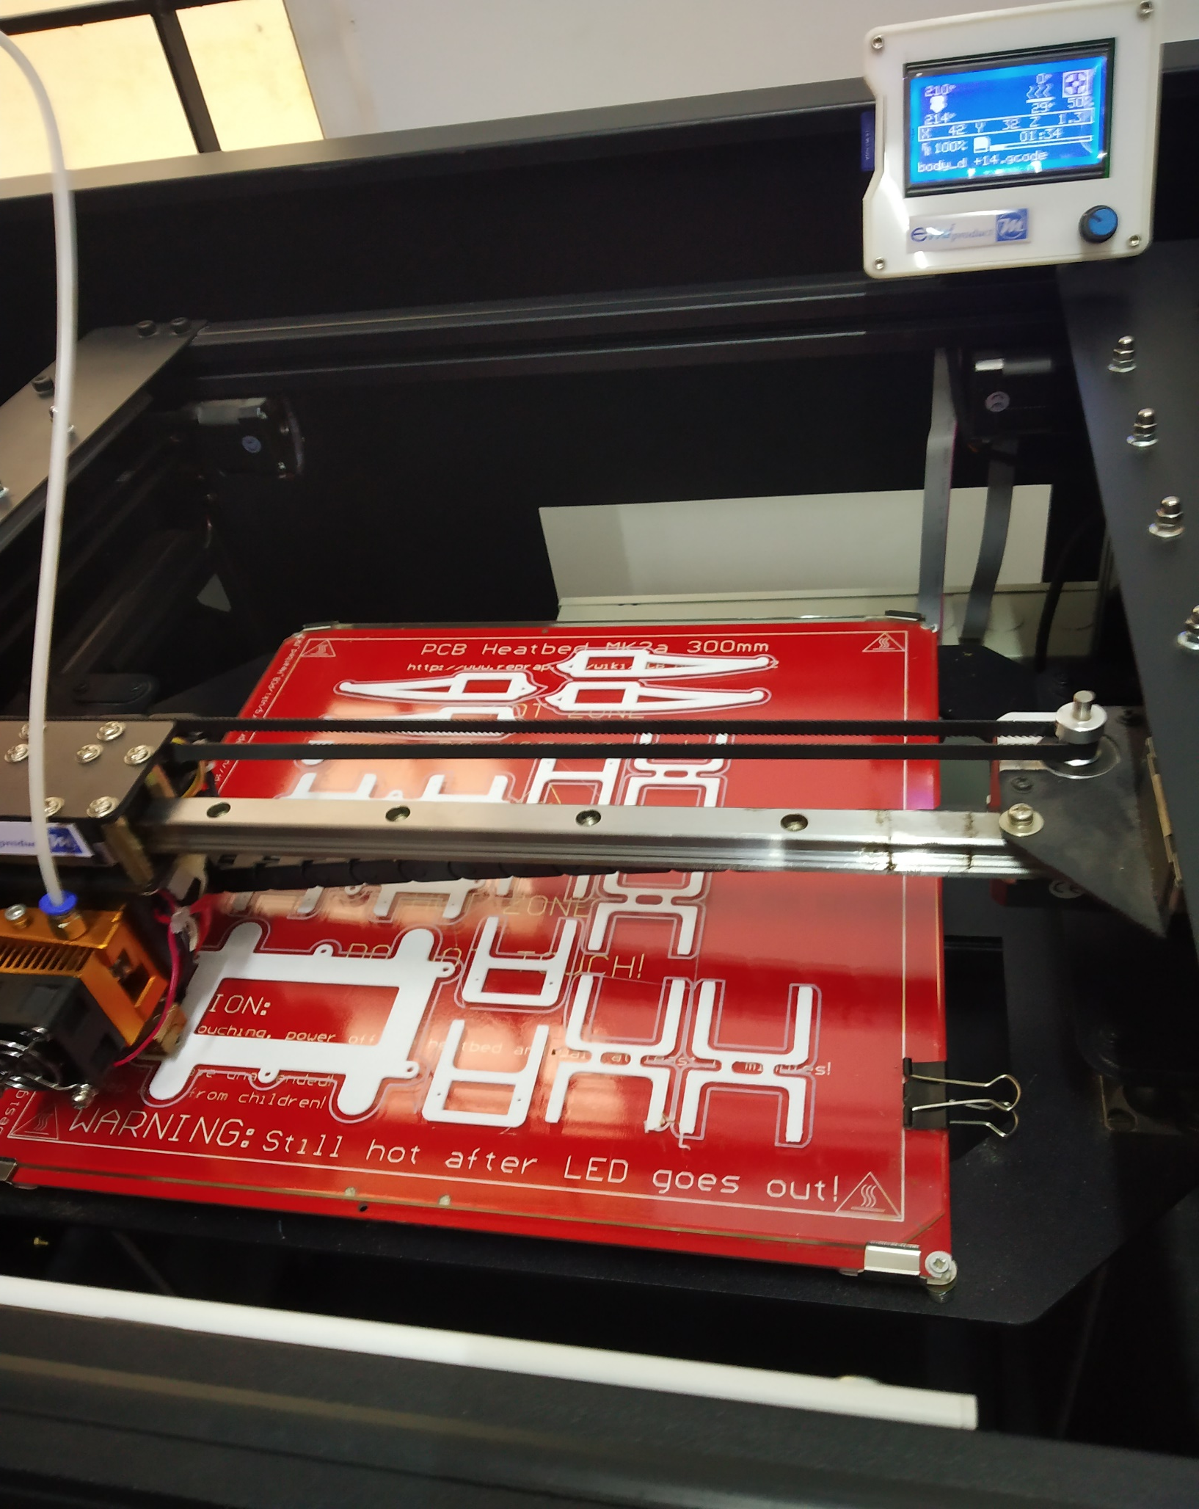
QUADRAPOD ROBOT
RAJARAJESHWARI NAGAR
BENGALURU
Introduction
Platform/execution methodology/etc.
The Android App
Talking about the android up it allows you to
connect to your robot through Bluetooth and make forward and backward movements and left right turnings
Conclusions
What Is a “Spider Robot?”
As its name defines it, our robot is a basic representation of the spider movements but it will not perform exactly the same body moves since we are using only four legs instead of eight legs.
Named also a Quadruped robot since it has four legs and make its movements using these legs, the movement of each leg is related to the other legs in order to identify the robot body position and also to control the robot body balance.
Legged robots handle terrain better than their wheeled counterparts and move in varied and animalistic ways. However, this makes legged robots more complicated, and less accessible to many makers. and also the making cost and the high expenses that a maker should spend in order to create a full body quadruped since it is based on servo motors or stepper motors and both are more expensive than DC motors that could be used in wheeled robots.
Servo Motors Are the Main Actuators
A servomotor as defined in wikipedia, is a rotary actuator or linear actuator that allows for precise control of angular or linear position, velocity and acceleration.
It consists of a suitable motor coupled to a sensor for position feedback. It also requires a relatively sophisticated controller, often a dedicated module designed specifically for use with servomotors.
Assembly
The body of the quadruped is assembled with
3d body printer which consists of legs assembly by fitting servo motors to it, body assembly and finally all four legs are attached to the body of the quadruped.
Thus, a quadruped robot is designed in such a way that humans can interact with it using android chatbot to perform some tasks. The movement of servos is achieved by Inverse kinematics algorithm.
The Arduino Quadruped robot will be able to move on a guided path sensing the black line with its automatic obstacle avoiding feature makes it efficient to reach any destination as desired.
ACKNOWLEDGEMENTS
Results
I thank all my teachers
Components Used
Contact information
Arduino Nano
Lithium Batteries
Servo motors
PLA for 3D printing of body
Bluetooth module HC05
GOWRAV S 1GA17EC042
HARSHITHA H R 1GA17EC049
AMOGH R 1GA17EC013
GLOBAL ACADEMY OF TECHNOLOGY
Rajarajeshwari Nagar
Bengaluru-560096
Email id :-
Contact :-
Size of original
Size it will be on the Poster

